Slide 1
Universal Tsunagari Car
Tomoki IKEGAMI, Akmal FAUZI
Team: MokiMal

Slide 2
Outline
Self introduction
Ideate
Product concept
Backgroud
How to make
Demo ( Video )
Summary
自己紹介
アイデア出し
製品コンセプト
背景
作り方
デモ（動画）
まとめ

Slide 3
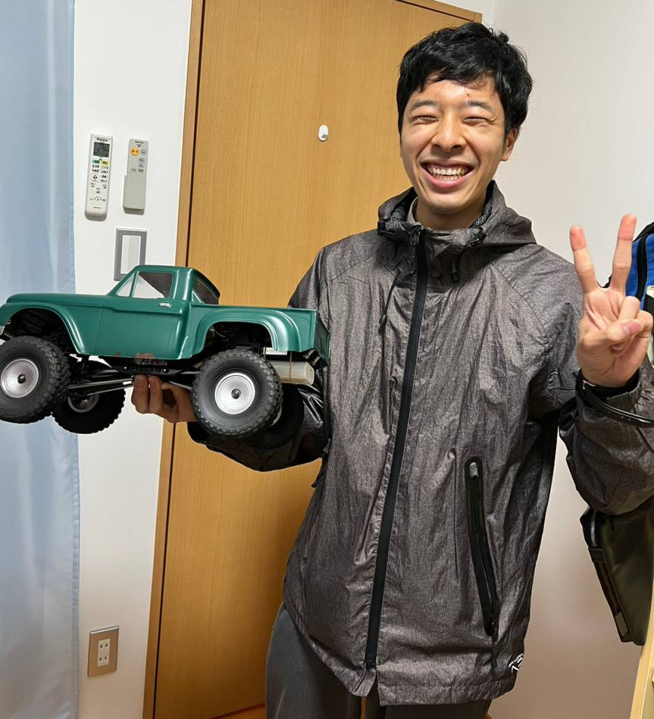
Self introdution (自己紹介)
Tomoki Ikegami
From
  Hokkaido, Japan
Affiliation
  Kanazawa Univ. (student)
Speciality
  Engineering (Robotics)
Hobby
  Radio controlled car

Slide 4
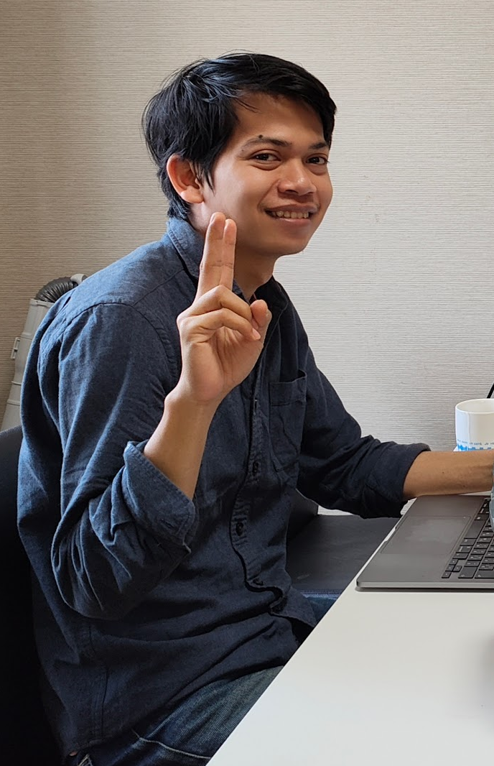
Self introdution (自己紹介)
Akmal Fauzi
From
  Makassar, Indonesia
Affiliation
  Kanazawa University
Speciality
  AI
Hobby
  Watching Movies

Slide 5
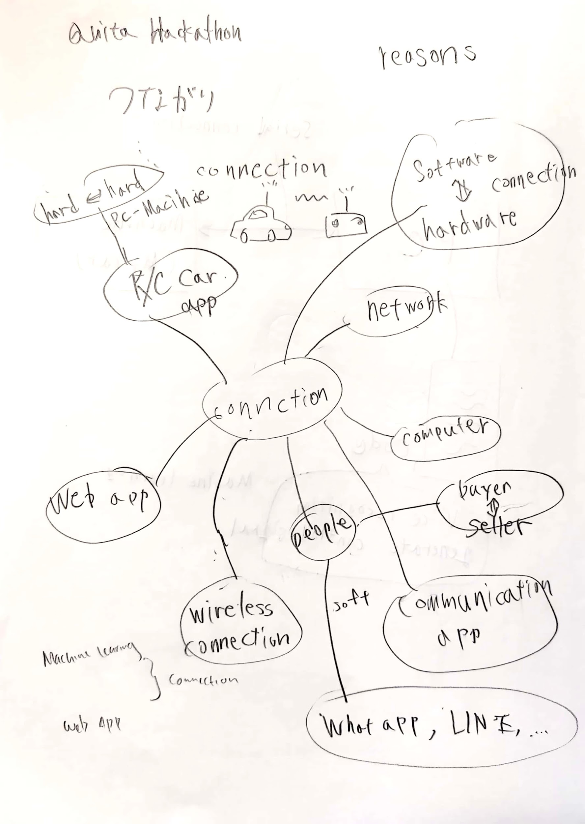
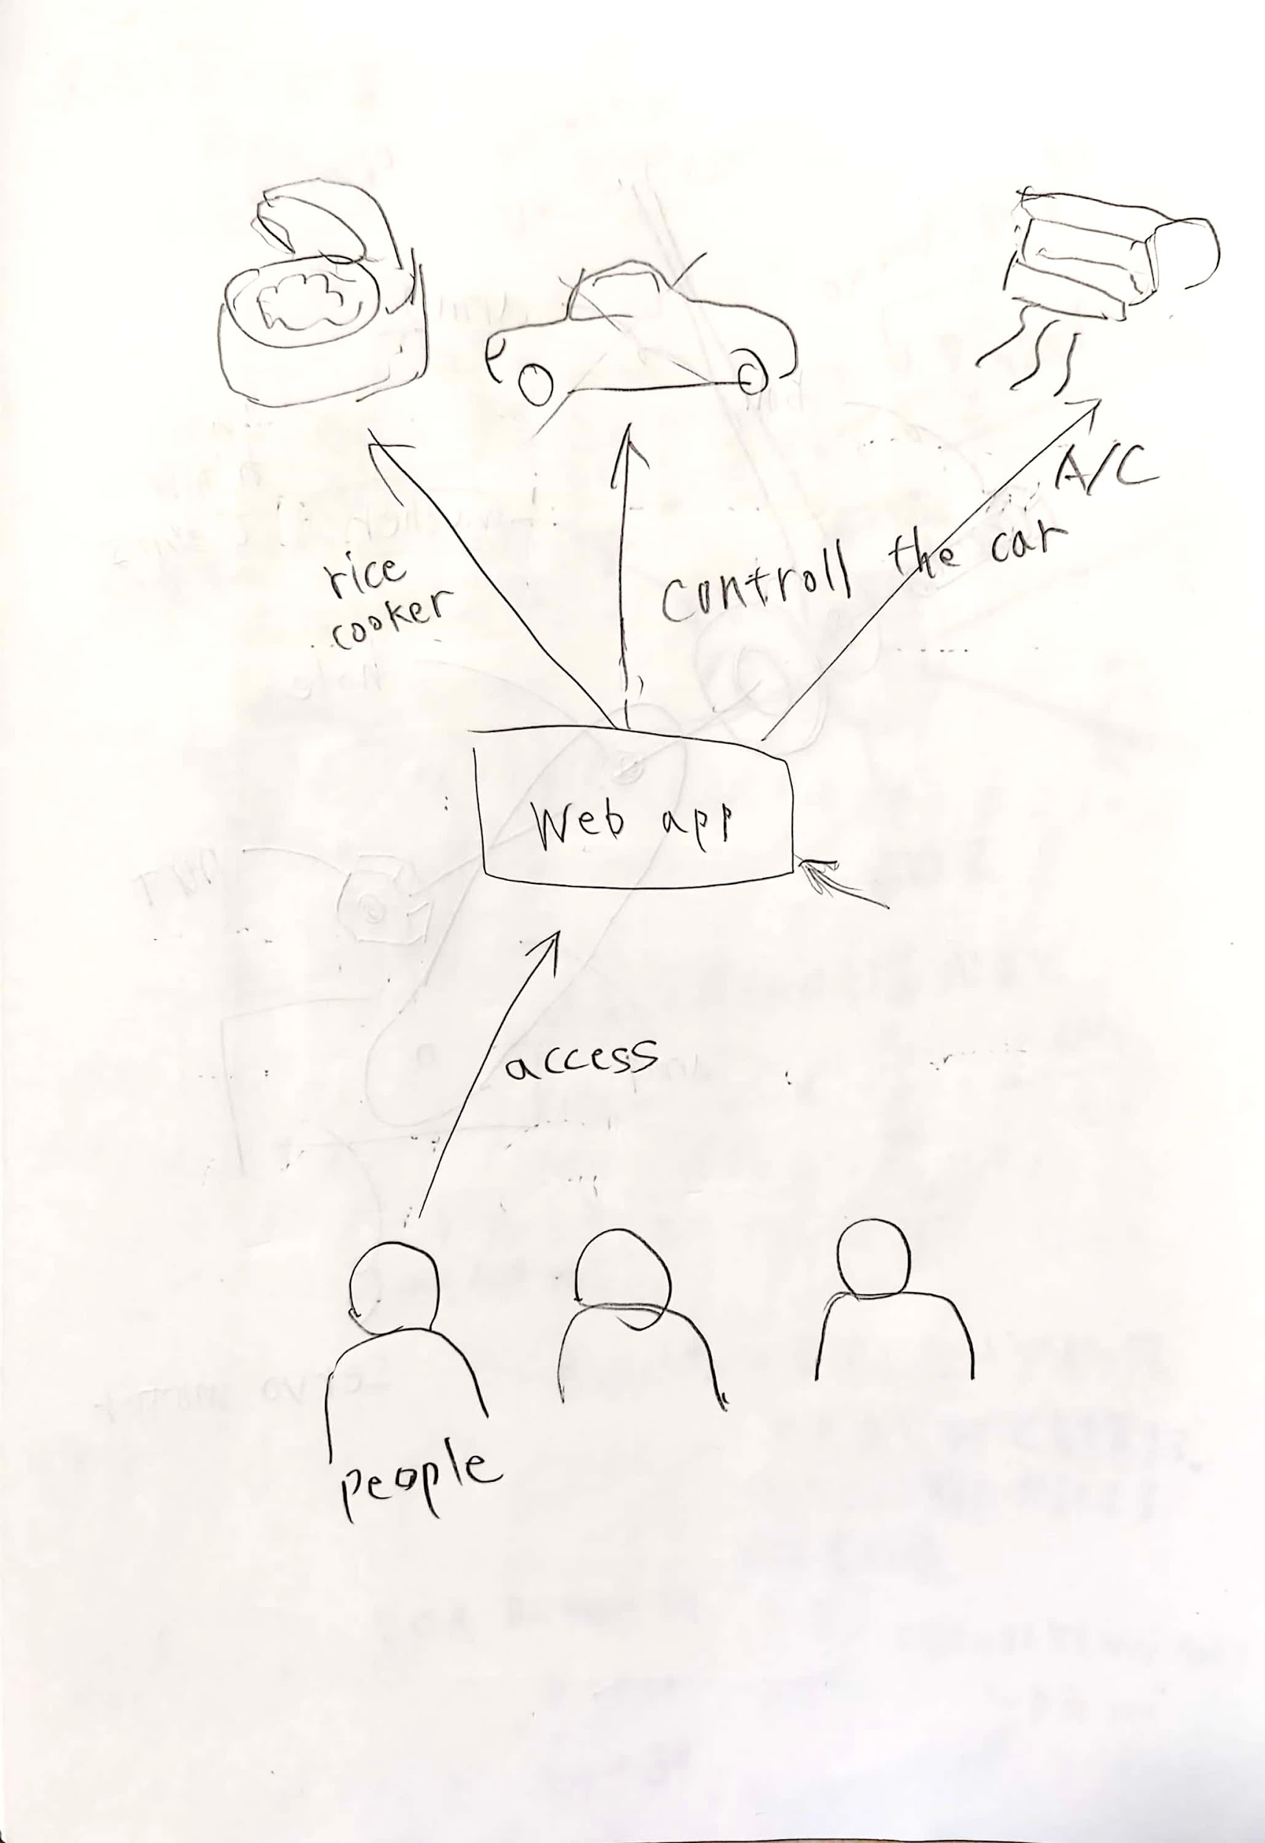
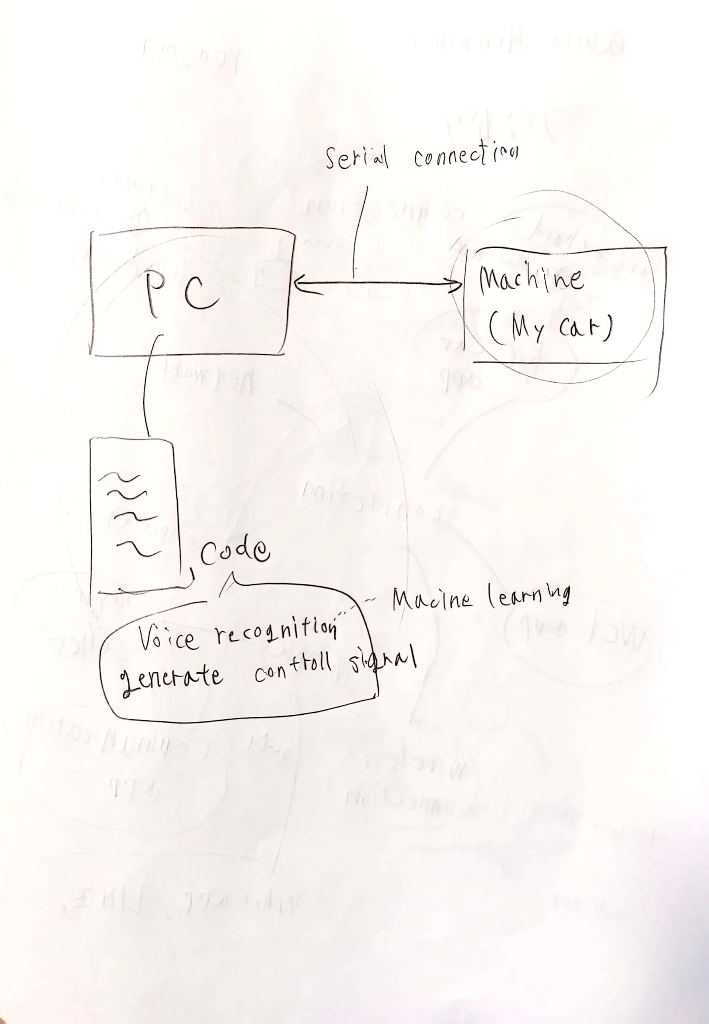
Ideate
(アイデア出し)
Tsunagari
（つながり）
Discussed with team member

Slide 6



Product concept（製品コンセプト）
◎Two types of tsunagari (2つのつながり)
Tsunagari
Tsunagari
People to people
Software to Hardware
ソフトウェアとハードウェアの
つながり
人と人のつながり

Slide 7
Background (背景:日常生活から...)
家電を操作するとき、
他言語の理解が必要
◎Need to understand another language
→Akmal faced challenges when he came to Japan because he could not speak Japanese, and most of the hardware labels are in Japanese. So, he needed to translate them first or ask Tomoki to understand the tools. That's why connecting people to the hardware is very important."
◎Cannot print all language ( the space is small )
☑ Hand Gestures are Universal Language is this world
だけど、全言語をプリントできないよ
ハンドジェスチャーが
最適！
Notes:
the problem is come from around us or ourself in daily life. we are living in dormitory international students

Slide 8
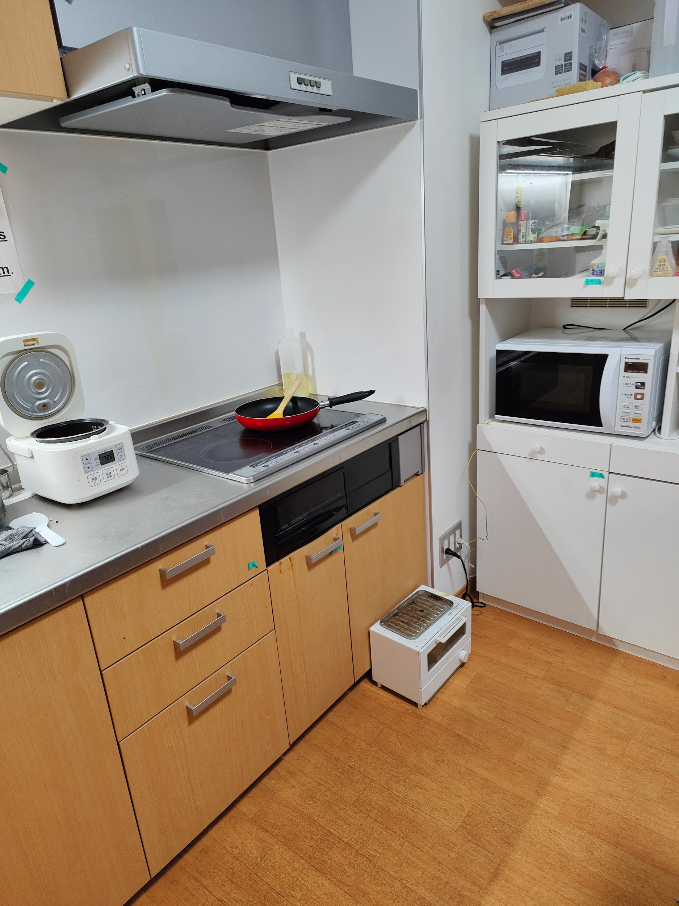
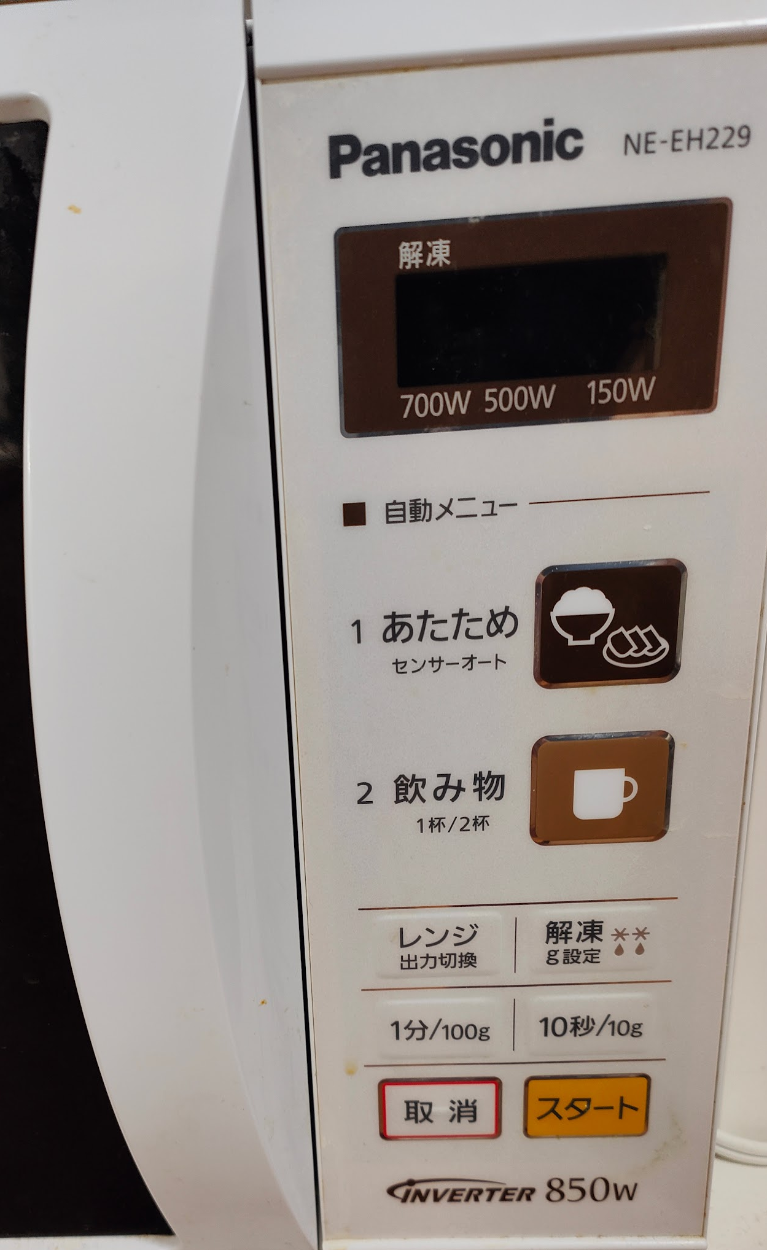
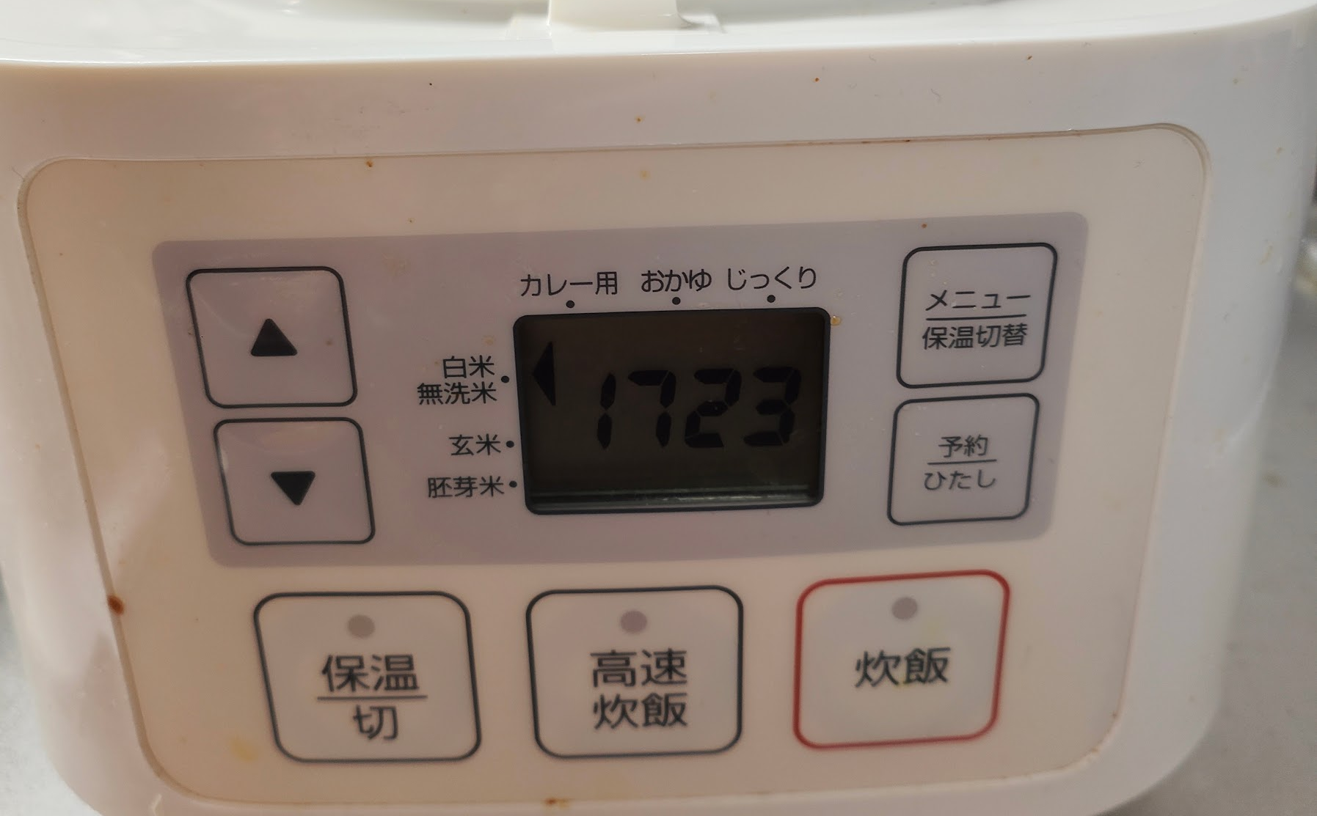
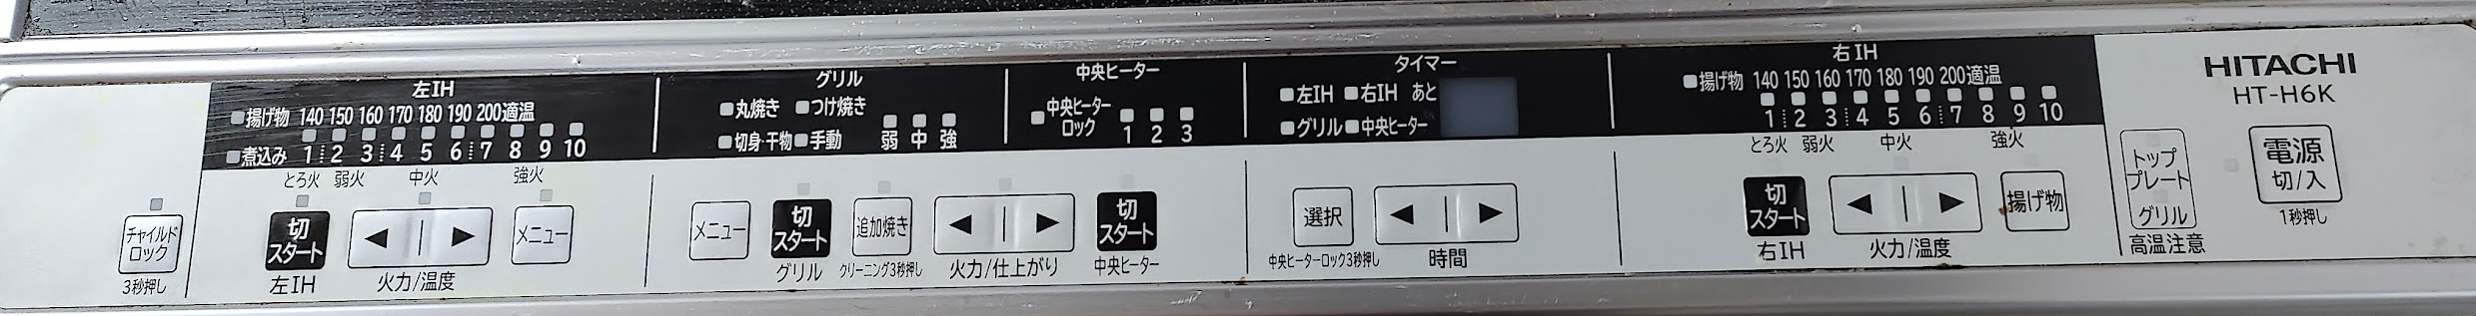
Background（背景） ~ Japanese hardware ~ 日本の家電
Japanese only…

Slide 9

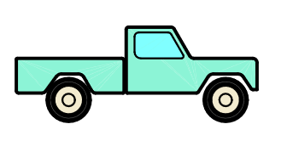

How to make ~ System oveview ~
BT connection
R/C car
PC
(Python)
Control
Notes:
we make two products until we decided to use the hand gesture, The first one is to control with type the direction using another language like indonesia, china, etc

Slide 10
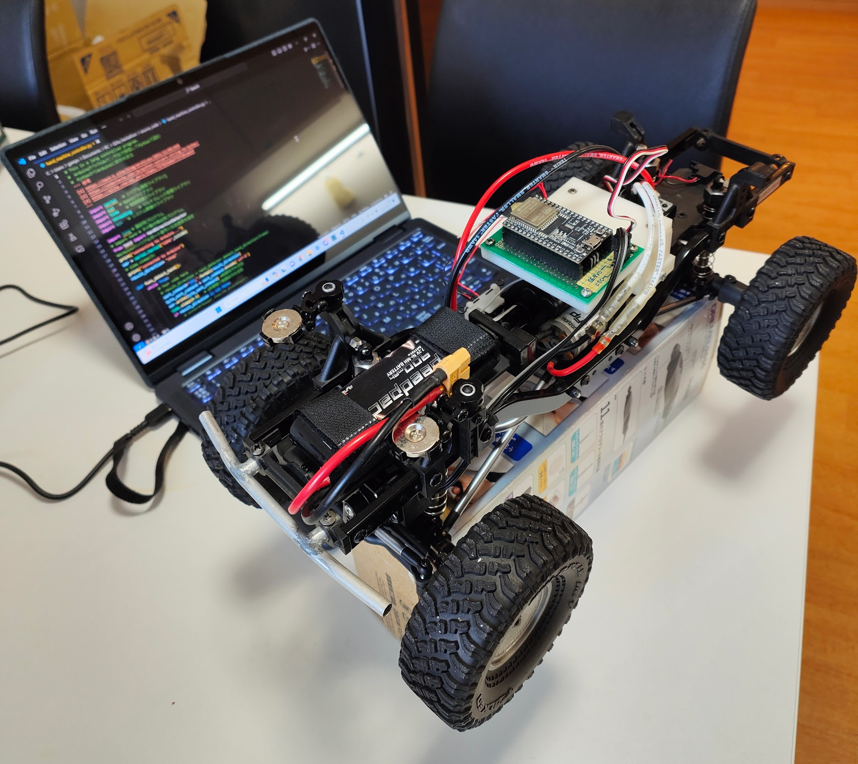
How to make ~ Hardware overview ~ 作り方、概要
Microconroller
(ESP32)
PC
(YOGA 670, Win11)
ラジコンを
ジェスチャーで操作する！
R/C car
(ECX Barrage 1.9)

Slide 11
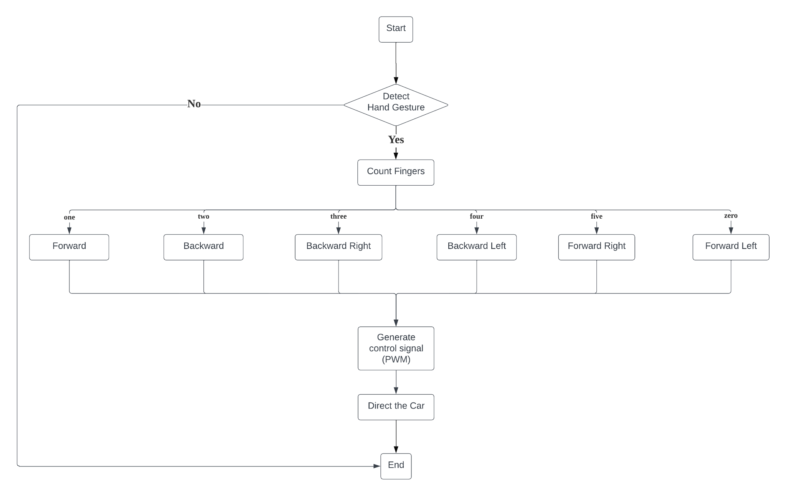
How to make ~ Software logic ~ ソフトウェア構成
ハンドジェスチャー
から制御信号生成
PC (Python)
ESP32 (C++)
ラジコンを制御
Notes:
The big challenge for us yesterday is to connect our code

Slide 12
How to make ~ Workflow ~ 作り方、作業の流れ
Tomoki: R/C control, BT connect（ラジコンの制御、無線接続）
Akmal: Image recognition, generate control signal
（画像認識、制御信号生成）
Tomoki
R/C car
PC
(Python)
BT connection
Control
Akmal

Slide 13
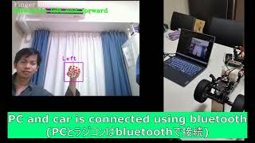

Slide 14
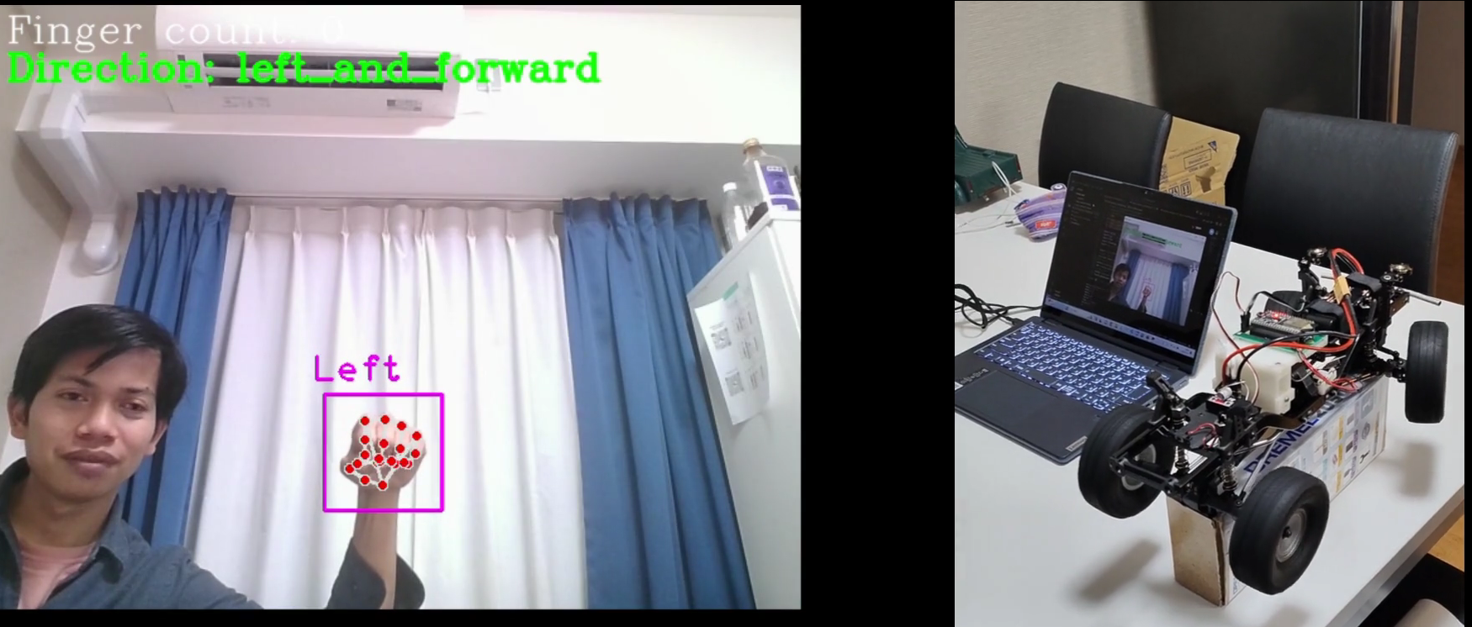
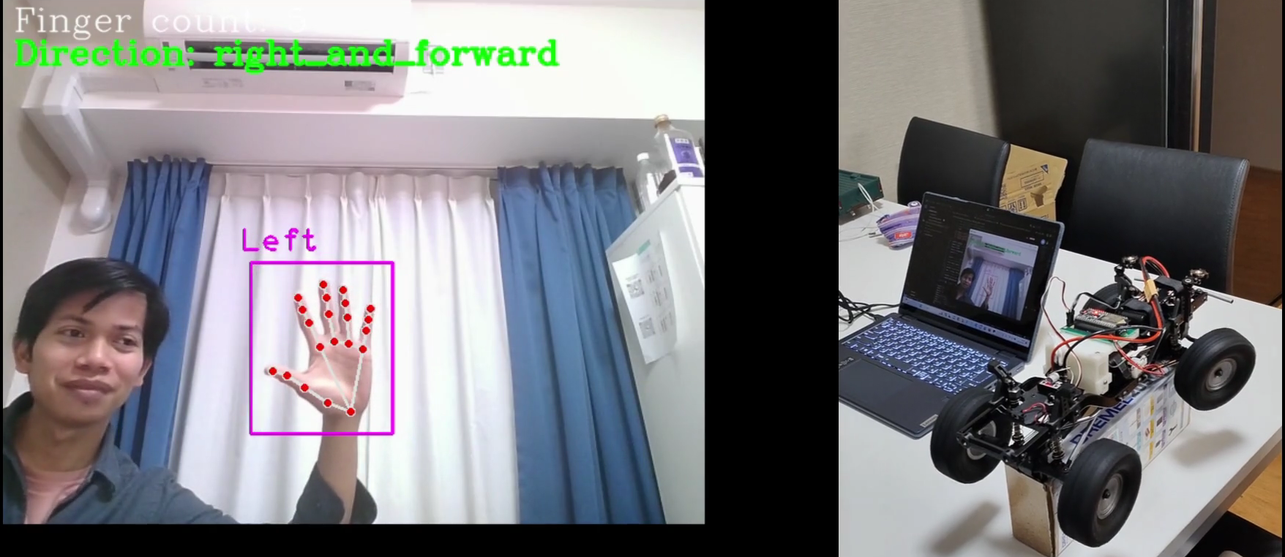

Slide 15
Summary
We made a hand-controlled device.
手で操作可能な装置を開発した
The device achieved connecting people to hardware
その装置は、人とハードウェアとのつながりを実現した
Tsunagari
Tsunagari
People to people
Software to Hardware

Slide 16
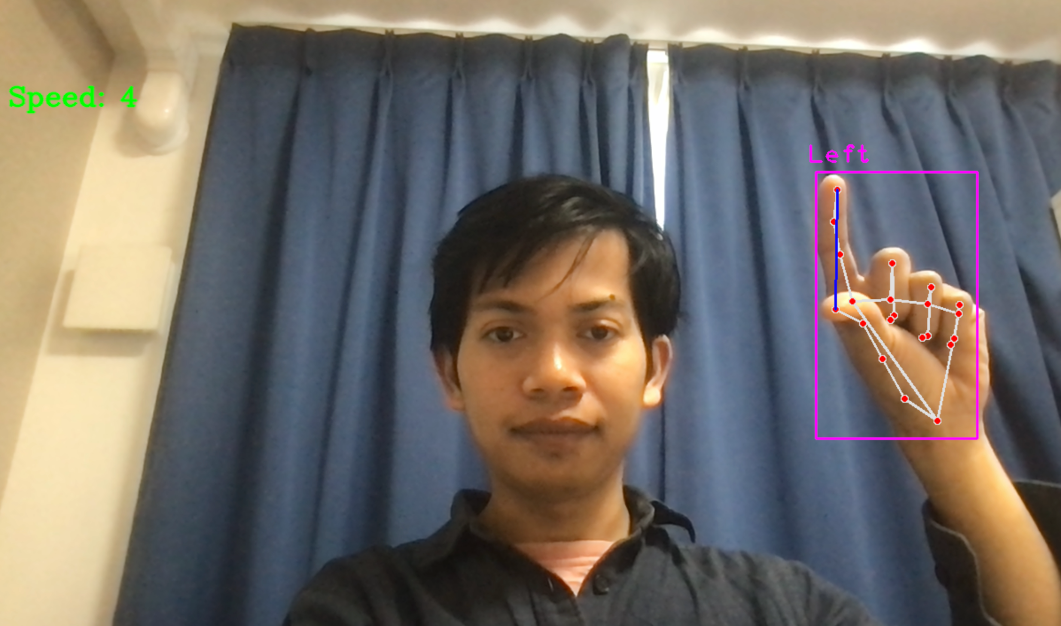
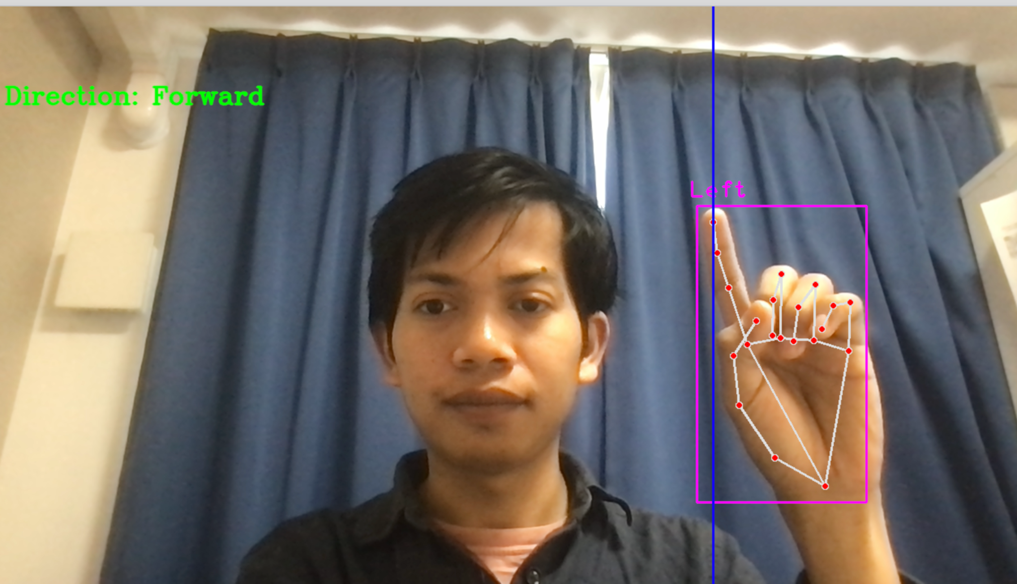
Next Development
Update the type of gesture detection (hand movement) for controlling the car and adjusting the speed,
（手で向きで方向制御、指の間隔で車速制御したい）
Apply it to another hardware.
（ラジコンでなく、他のハードウェアにも適用したい）

Slide 17
References
https://qiita.com/umi_mori/items/757834e0ef75f38cea19
https://tomson784.github.io/memo/python/arduino/2021/05/25/pyserial-arduino.html
https://tanudon.work/499/
https://next-k.site/blog/archives/2021/12/09/645
https://codechacha.com/ja/python-convert-string-to-bytes/
https://github.com/cvzone/cvzone

Slide 18
ありがとうございました！
Terima kasih!
(↑ インドネシア語の”ありがとう”)

